Slide 1

Final Project: Investigation of Medication Adherence using Survival Analytics Methods
Erin Rebholz CSCI- 82 Fall 2023
Slide Template Credit: https://slidesgo.com/faqs
Photo Credit: https://rtm.ai/eng/tech-bites-time-series-101-defining-time-series-data-en/

Slide 2
Adherence Analytics: Project Background and Plan
Data Sets Considered
Selected Focus Areas
Results
SyntheaMass
RxNorm
FDA NDC Directory
Good Coverage in Statins
Data Not Useful either perfectly adherent or dead ☹
Licensed DEID
Pharmacy Data Set
Three Therapeutic Areas
GLP-1s
Best Data Coverage
Today’s
Presentation
Analytic Process
Exploratory Data Analysis
Censor | Duration Calculation
Initial
Kaplan Meier Cox PH Curves
Train | Test Split
Predictions
Cox, Random Forest,
Boosting, DeepSurv
Documentation Challenges
Merilytic Health, LLC Proprietary and Confidential: Not for Further Disclosure Outside of Harvard Extension School: CSCI-82 Fall 2023 Class Participants

Slide 3
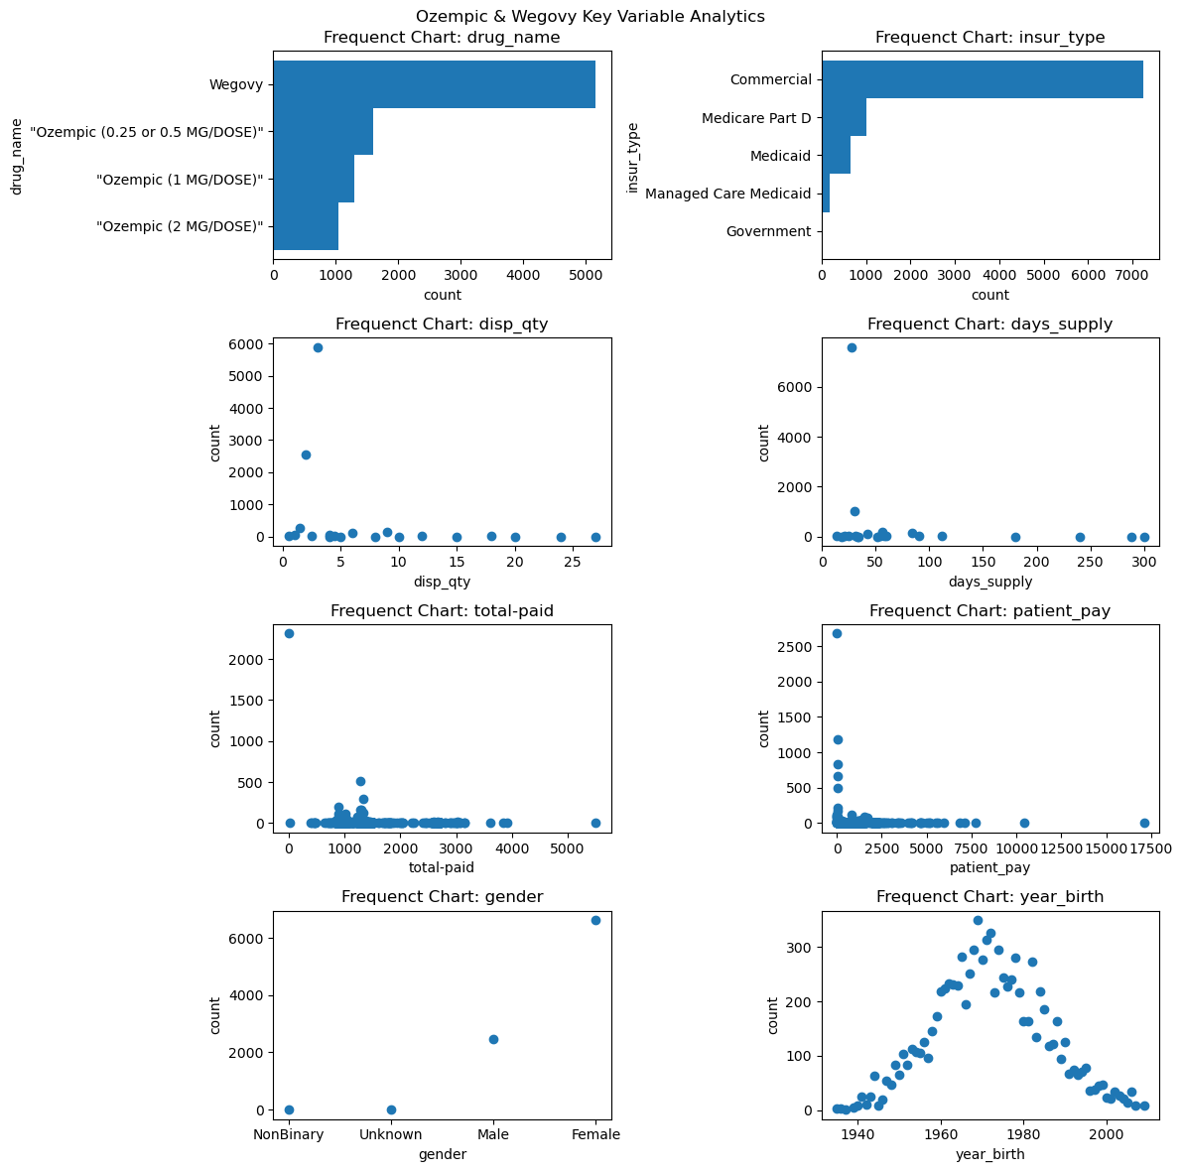
Switched to a proprietary deidentified data set and selected GLP-1s as the drug of interest for our adherence study:
Key Descriptive Statistics for Study Population:
Count values = by fill
Majority low patient pay
3
28 days
Majority Women
2
30 days
Unique Patients = 3,162
Unique Fills = 9,102
Study period: 1/1/2023 to 12/1/2023
40’s and 50’s
Merilytic Health, LLC Proprietary and Confidential: Not for Further Disclosure Outside of Harvard Extension School: CSCI-82 Fall 2023 Class Participants

Slide 4
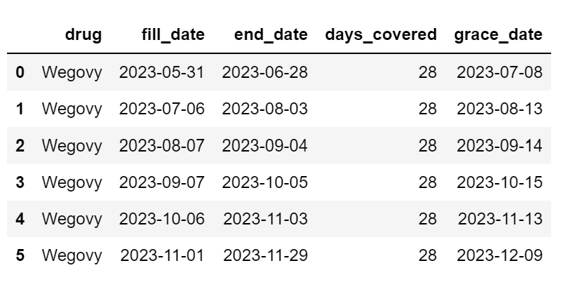
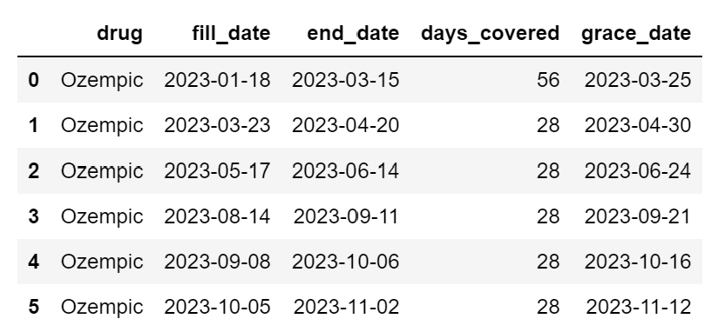
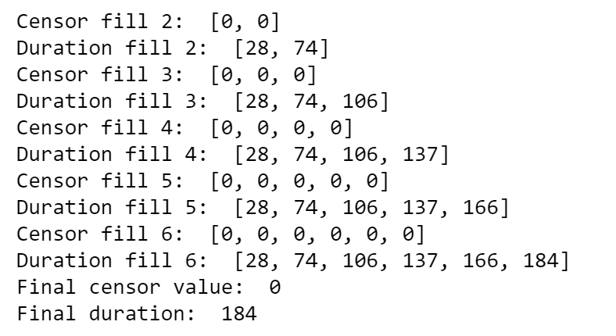
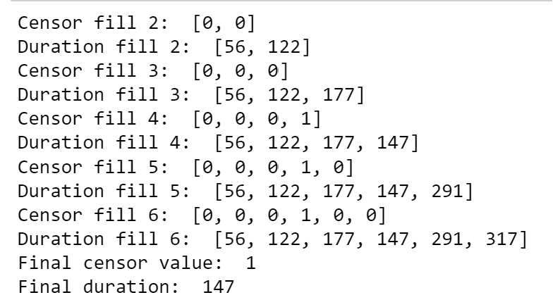
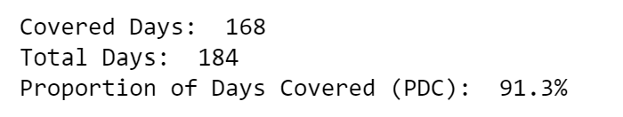
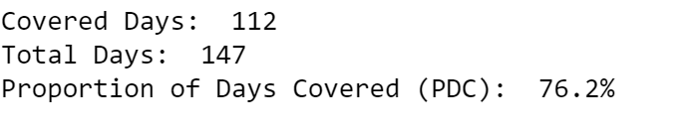
Calculating censor values for pharmacy fills involves checking to make sure refills occur within a grace period
Grace Period = 30 days
Patient Example [10]
Compliant throughout:
Patient Example [85]
Misses grace for fill:
fill behavior
censor & duration calcs
censor & duration calcs
At end of study
At time of censor
pdc
Merilytic Health, LLC Proprietary and Confidential: Not for Further Disclosure Outside of Harvard Extension School: CSCI-82 Fall 2023 Class Participants

Slide 5
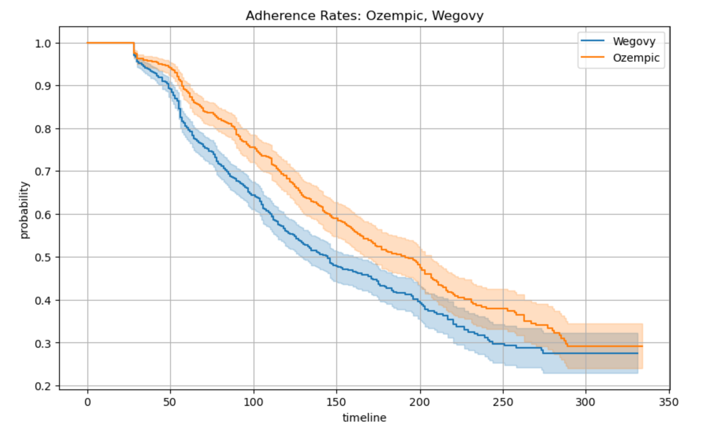
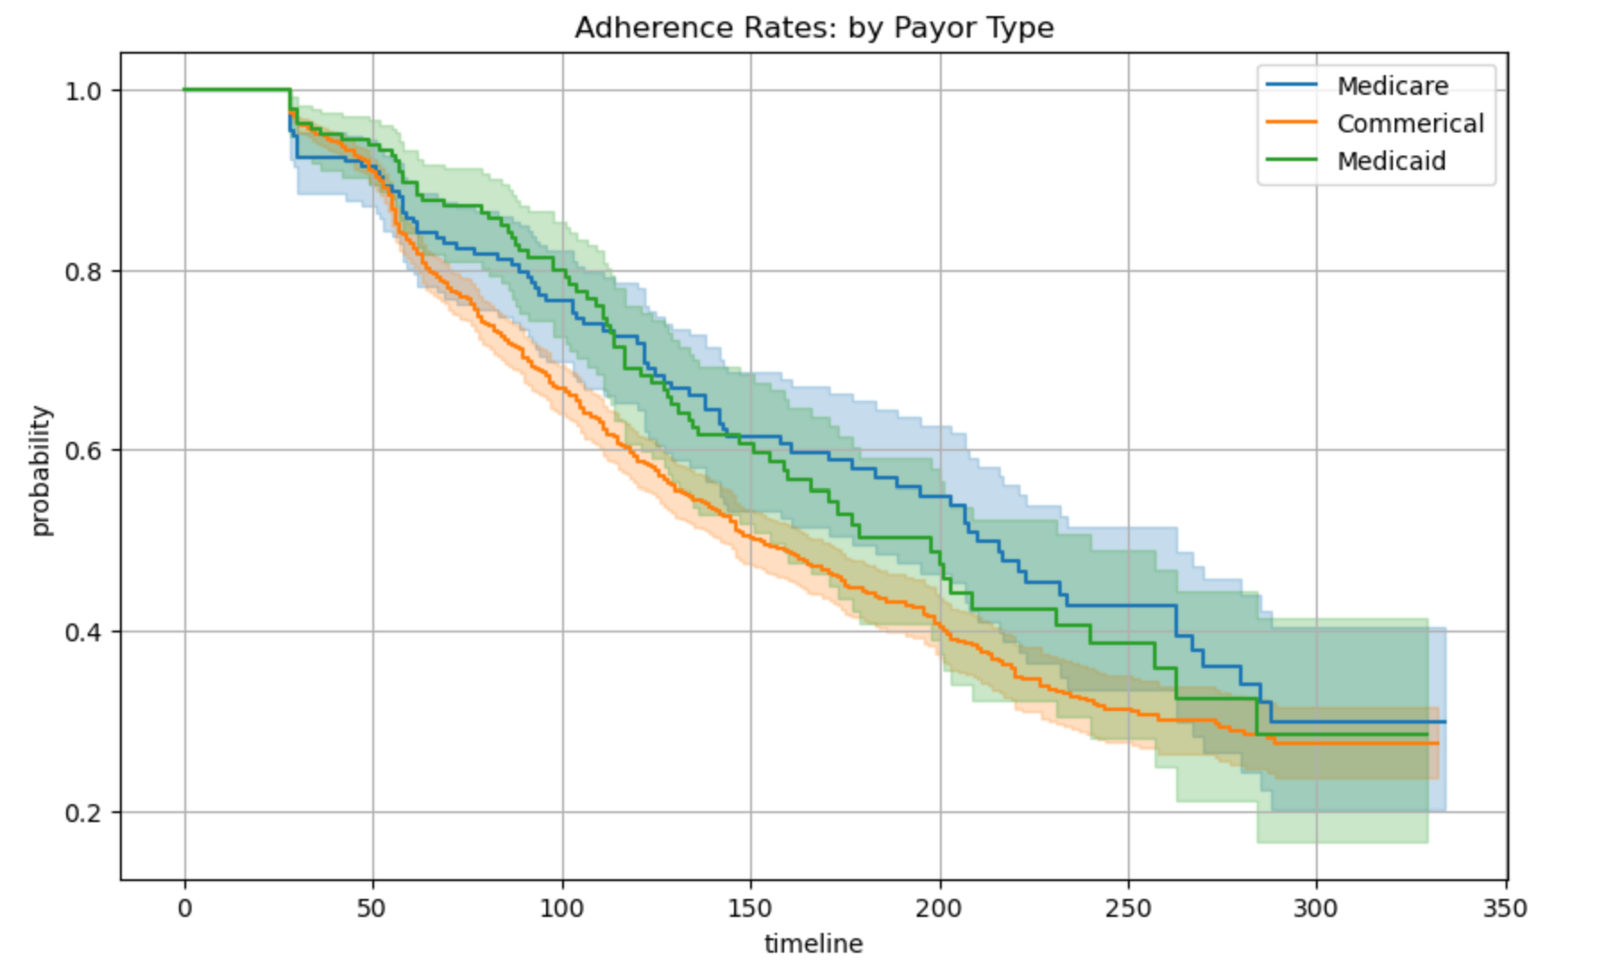
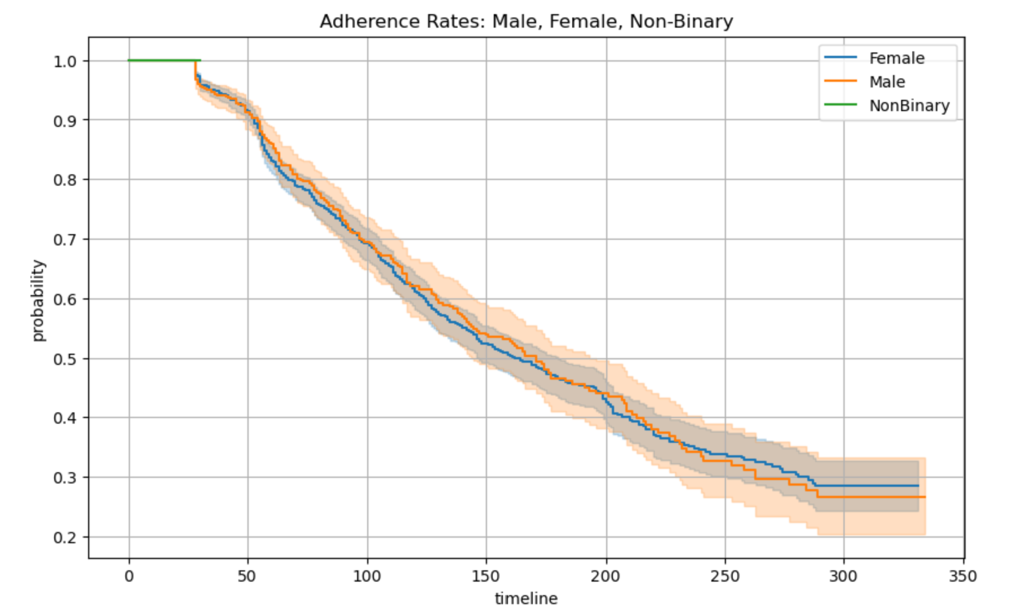
Kaplan Meier curves can be plotted for categorical variables to show impact to adherence rates
Ozempic patients, most likely taking drug for diabetes, shows higher probability for adherence
Medicare patients show higher adherence rates than Commercial patients
Female patients slightly less adherent at first then Male patients, …
Wegovy is a chemically similar drug, but indicated for weight loss, but shows lower adherence
Medicaid patients start out strong with adherence probabilities similar to Medicare, but then declines over time to meet commercial adherence rates
but in later periods trend reverses and Male adherence declines. Non-binary does not have enough data to fully plot
Merilytic Health, LLC Proprietary and Confidential: Not for Further Disclosure Outside of Harvard Extension School: CSCI-82 Fall 2023 Class Participants

Slide 6
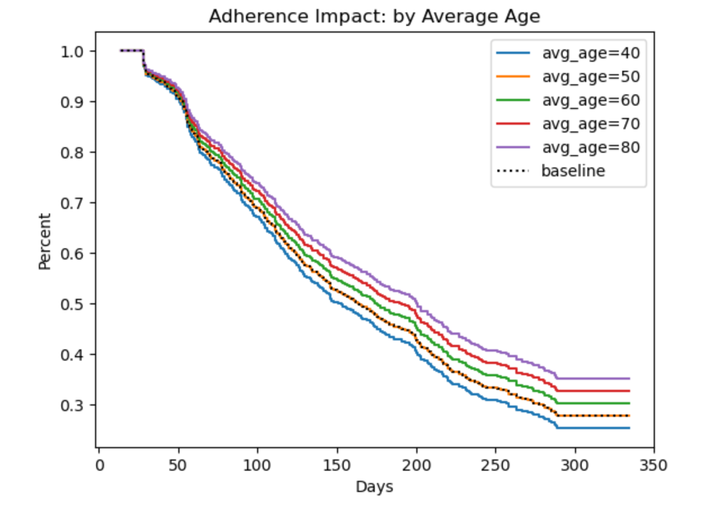
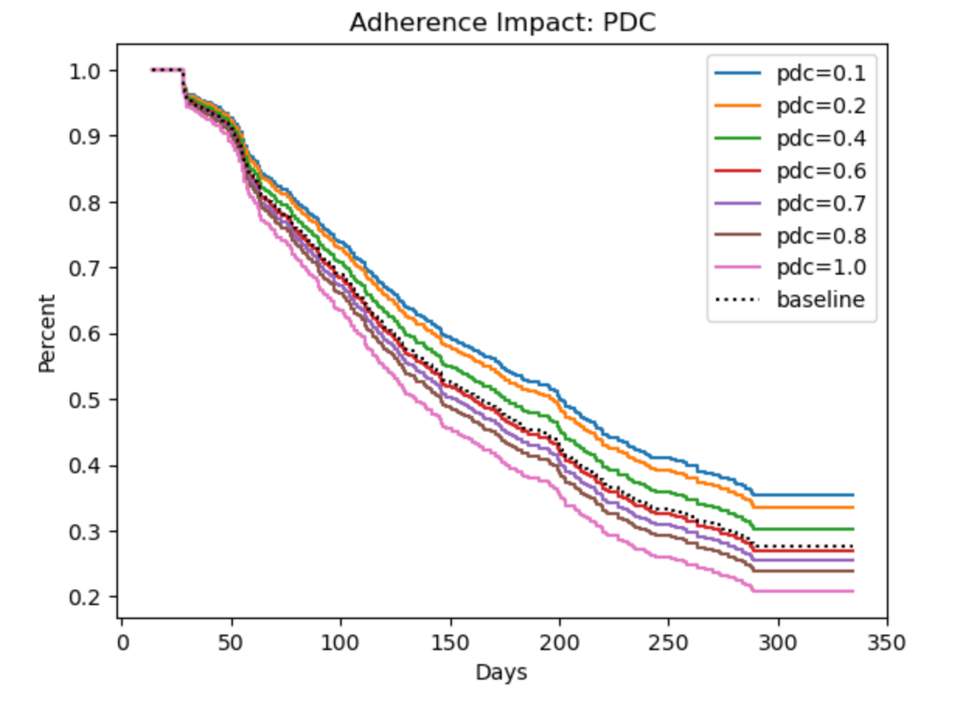
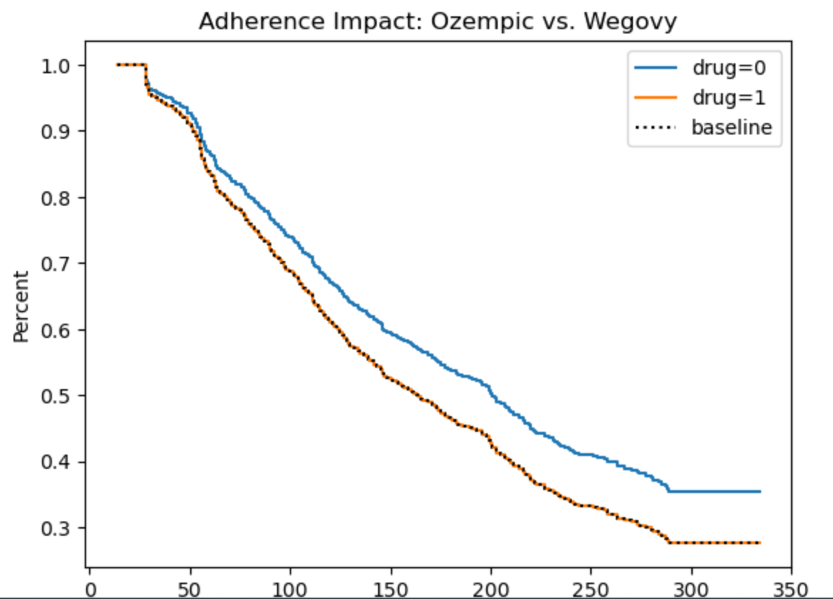
Cox proportional hazards analysis shows that the two significant variables impacting adherence rate are average_age, drug, and pdc score.
Wegovy =1
Ozempic = 0
Gender, payor type, patient_pay, and gender are not significant at a 95% confidence level.
Merilytic Health, LLC Proprietary and Confidential: Not for Further Disclosure Outside of Harvard Extension School: CSCI-82 Fall 2023 Class Participants

Slide 7
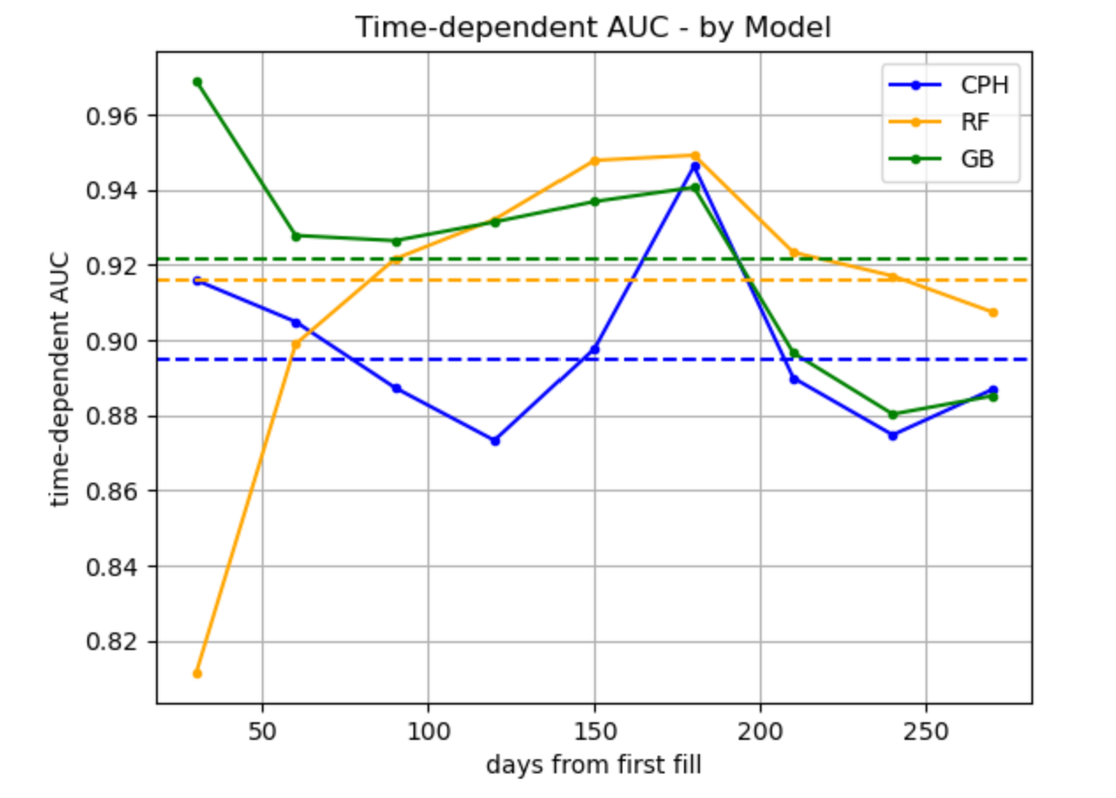
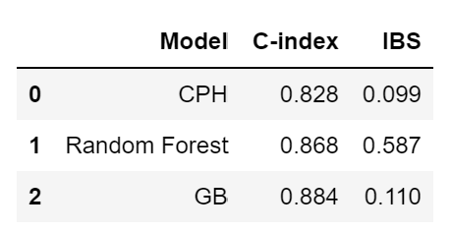
Cox Proportional Hazard, Random Forest, and Gradient Boosting were first used to predict censor events
Balance between high c-index and low IBS
Mean AUC
The concordance index is interested in the order of the predictions, not the predictions themselves
IBS, or integrated brier score, checks to see how well the predicted value aligns to actual curve. The lower the IBS the better.
Model predictions improve as more patient data available. Questions is how to include more features to get more insights on patients in of drug use to better predict adherence.
Merilytic Health, LLC Proprietary and Confidential: Not for Further Disclosure Outside of Harvard Extension School: CSCI-82 Fall 2023 Class Participants

Slide 8
Model 2.0+
Reformulate into a Pipeline
Incorporate Additional Raw Metrics (Possible Now)
Product | Feature Questions to Explore
(Future)
Roll up key patient features
Amend data weekly based on new data
Create a rolling prior PDC calculation: prior 3 months, 6 months 12 months
Prior Authorization | Rebill Info
Manufacture Coupon Program Impact
Payor details: BIN/PCN/Employer
Multiple Medications Use
Average PDC scores for other chronic care medicines
Med Sync Impact
What features and insights are actionable by pharmacists?
What feature or insights would be helpful for manufacture questions?
Can we incorporate patient feedback questionnaires at key points (e.g. 1^{st |} 2nd refills?)
Can we incorporate biometric data as an outcome of interest or predictor?
Merilytic Health, LLC Proprietary and Confidential: Not for Further Disclosure Outside of Harvard Extension School: CSCI-82 Fall 2023 Class Participants

